Slide 1
The Rise of Craft Brewing in Indiana
1999-2022: Thirty-Three Years of Fresh Local Beer

Slide 2
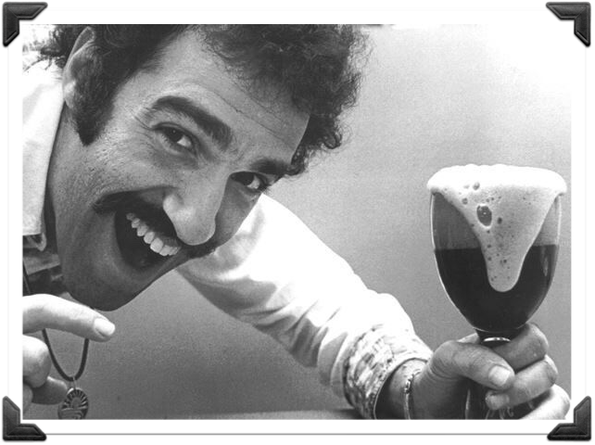




1978- The US Congress passes legislation legalizing home brewing. It allow each adult member of a household to produce up to 100 gallons of beer annually for personal consumption
1980- Charlie Papazian releases The Complete Joy of Home Brewing, which becomes a virtual brewing bible for a new generation of brewers, myself included

Slide 3
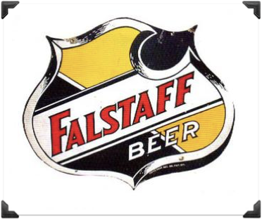

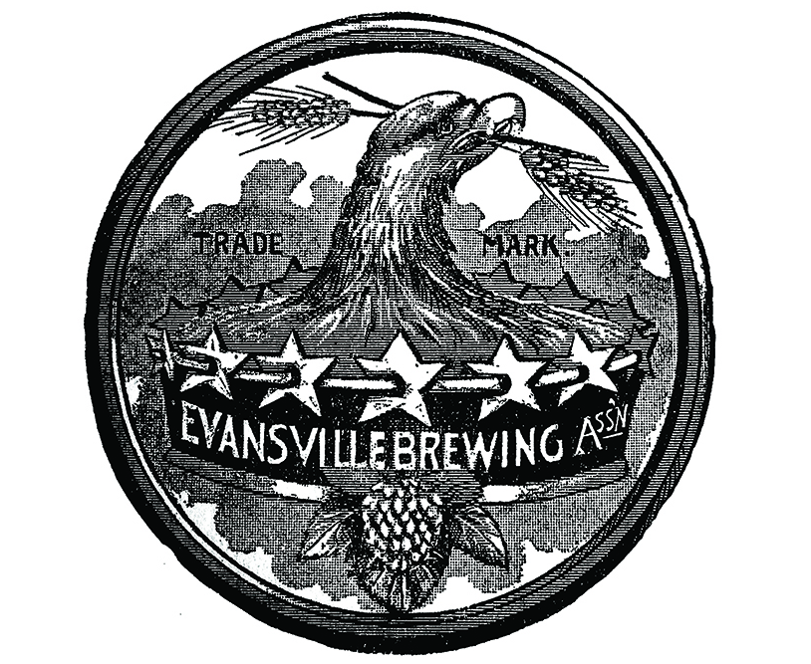
1988- From a high of over 200 breweries at the turn of the 20th century, only two commercial breweries remain in the state: Falstaff/General Brewing in Ft Wayne and Evansville Brewing in Evansville. Though owned & operated by large brewing entities, both would close by the end of 1997

Slide 4
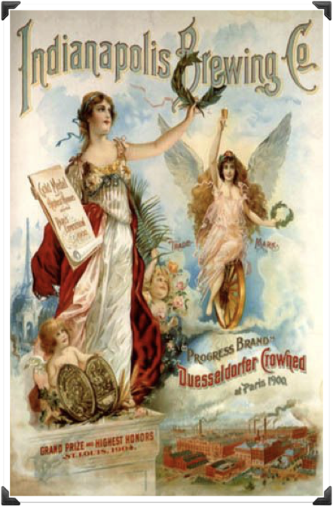
1989- Taking a name from Indianapolis brewing history, Indianapolis Brewing Company opens its doors to be come the first modern “micro brewery” in the state. The 20 bbl brewery operated strictly as a production facility. At the time, Indiana law prohibited breweries from serving their own product by the glass or holding a separate retail permit. The ownership at IBC was kind enough to open their doors to the home brewing community for tours and meetings.

Slide 5
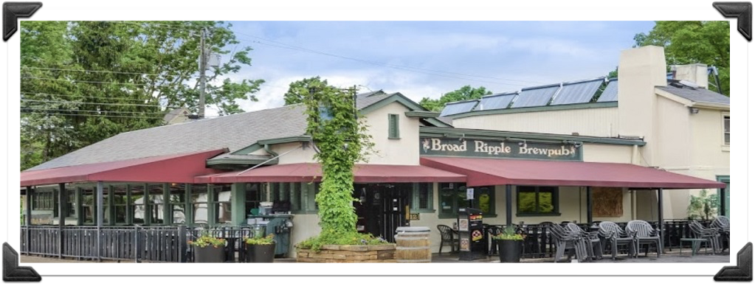

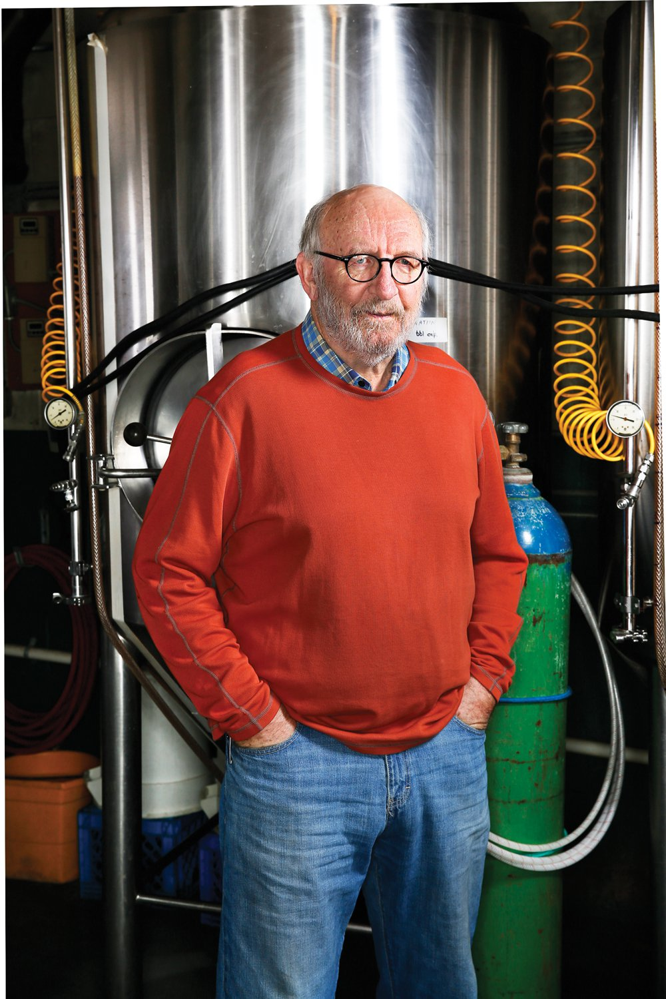
1990- Broad Ripple Brewpub and Broad Ripple Brewing Company open simultaneously in adjacent locations in Broad Ripple Village, Indianapolis. Though viewed by the public as simply the Broad Ripple Brewpub, they had to operate as two separate entities. John Hill owned the brewery while his wife, Nancy, owned the brewpub. With this creative approach, the Hills received permission from the Alcohol Tobacco Commission to provide for bulk transfer from the brewery into tanks in the restaurant. This set the stage for future legislation for Indiana’s small brewers.

Slide 6
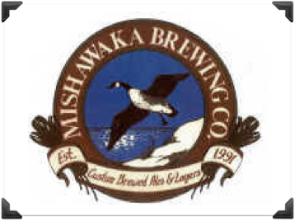

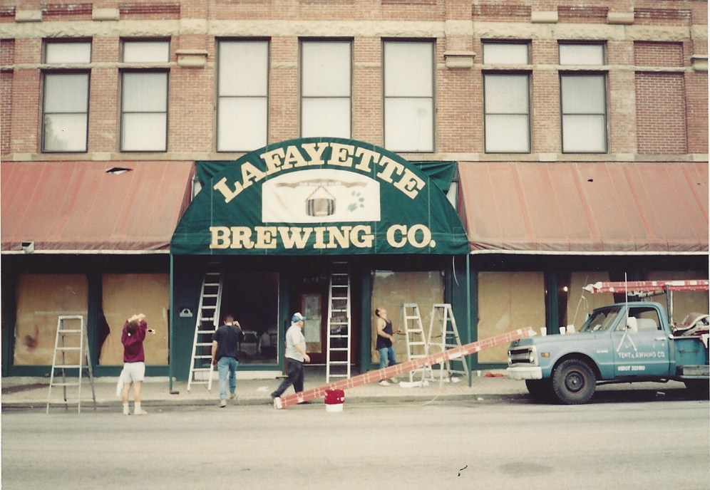
1992- Following a plan similar to the Hills, Tom Schmidt and partners open Mishawaka Brewing Company and their adjacent brewpub. Again, the ATC approves a bulk transfer situation from the brewery to the restaurant.
1993- Taking the lead from the Broad Ripple and Mishawaka, Greg Emig, his wife Nancy, and brother Joe begin construction on a new brewery and brewpub in an old furniture building on Main St in downtown Lafayette.

Slide 7
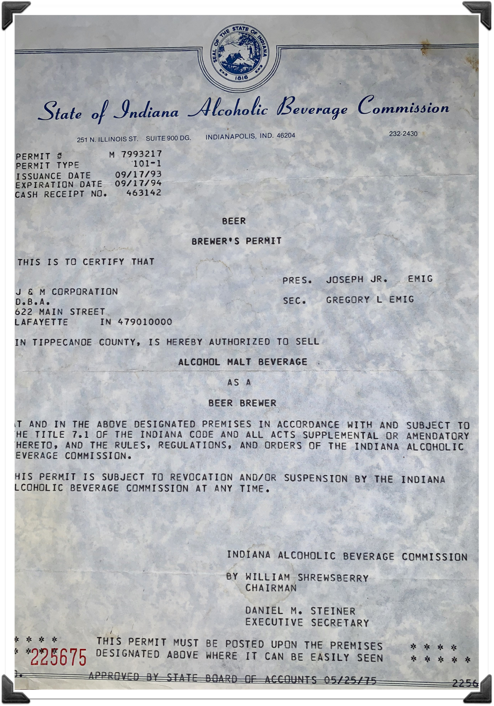
1993- During construction, Greg Emig is contacted by Jeff Mease, owner of Pizza Express and Lennie’s in Bloomington, seeking to pursue formal brewpub legislation in Indiana. Mease and Emig meet with Bloomington area legislators to draft a new small brewer bill. The bill passes on the first attempt and goes into effect on July 1, 1993. The Emigs amend their applications to the state and Lafayette Brewing Co is issued the very first small brewers permit in the state.

Slide 8
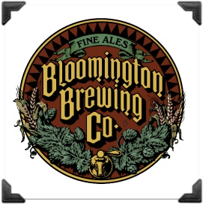

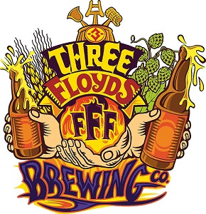

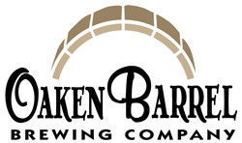

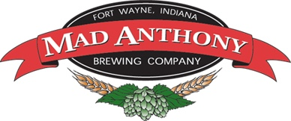
1994 to 1999- With the new small brewer legislation in place, breweries begin opening across the state. In all, 20 breweries would open in Indiana before the end of the decade, among them: Jeff Mease’s Bloomington Brewing, Oaken Barrel (Greenwood), Three Floyd’s (Hammond), Mad Anthony (Ft Wayne) and Upland (Bloomington). Unfortunately, the late ‘90s also saw several other Indiana breweries open and subsequently close. The national media declares the microbrewery “fad” as dead.

Slide 9
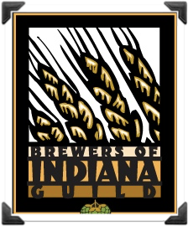

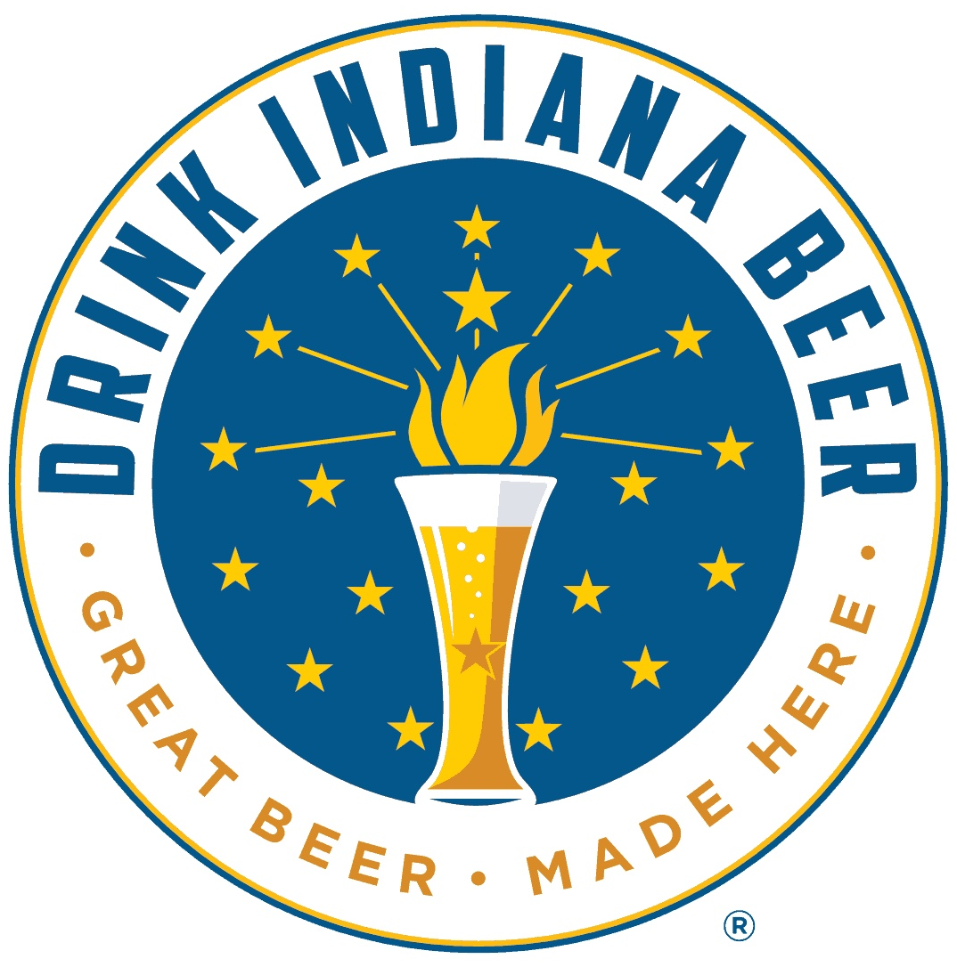

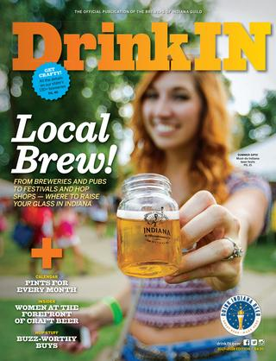
2000- Brewers across the state join forces and form Brewers of Indiana Guild (BIG) to provide a unifying voice for the small brewing industry in Indiana. The guild’s initial focus was to advocate for positive legislation to help advance the interests of the state’s microbrewers. Fundraising for the organization takes the form of beer festivals, including the Indiana Microbrewers Festival (summer) and Winterfest (winter). These events saw great numbers of people gathering to sample and celebrate the craft beer culture.

Slide 10
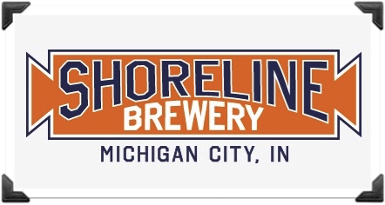

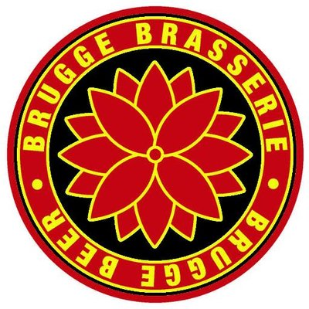


2001 to 2008- Despite dire predictions from the media, small breweries continue to open across the state- albeit at a slow, but steady, rate. Notable openings included: Brugge (Indianapolis), Shoreline (Michigan City), Half Moon (Kokomo), New Albanian (New Albany) and Crown (Crown Point).

Slide 11
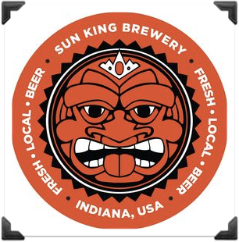

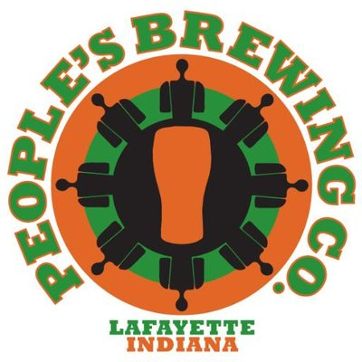


2009 to 2010- A new dawn in Indiana craft brewing begins as several new breweries open across the state, including: Sun King (Indianapolis), People’s (Lafayette), Flat 12 (Indianapolis) and Bier (Indianapolis). 2010 also saw a seminal piece of legislation pass: Sunday sales of carryout beer were allowed at the state’s small breweries for the first time since Prohibition. This bill opened a new market for Indiana small brewers as even non-craft drinkers were drawn to their local brewers to take advantage of Sunday carryout sales.

Slide 12


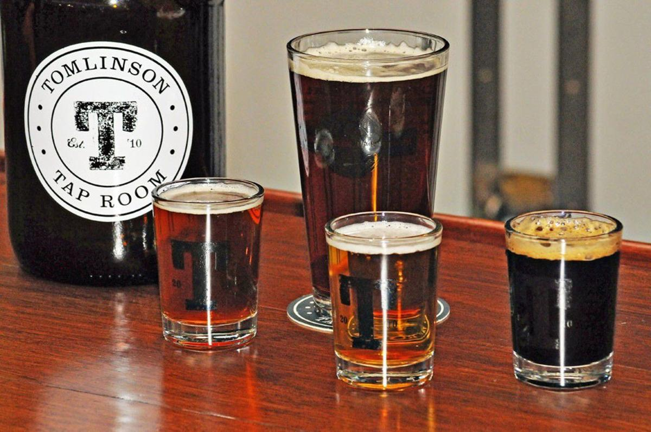
2010- BIG works with Indianapolis City Market and the City of Indianapolis to open the Tomlinson Tap Room in November- a joint venture between the guild and Indianapolis City Market.
2011- BIG works with the legislature to allow carryout for Tom Tap making it the first non-brewery in the state permitted to fill growlers.

Slide 13
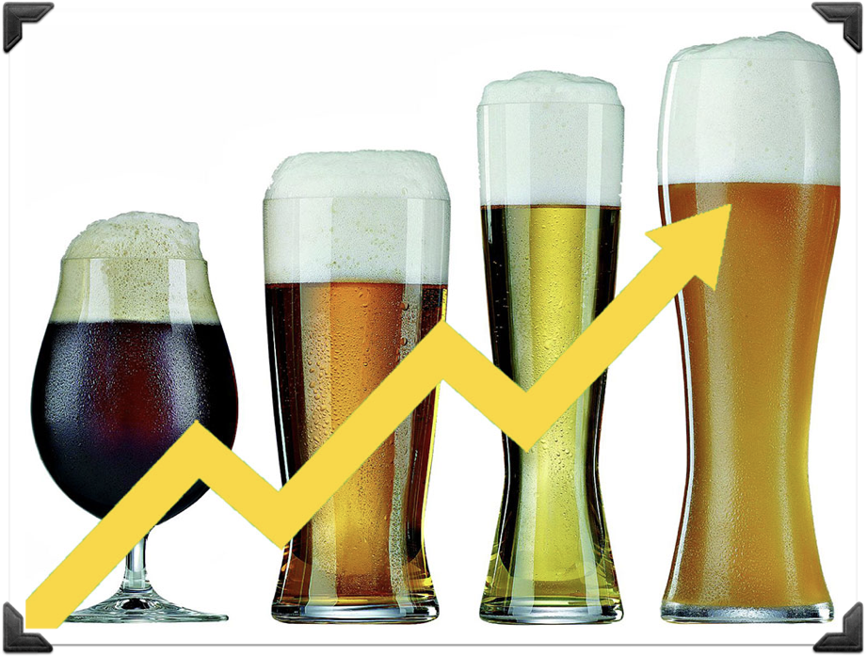
2011 to Present- A literal explosion of small brewery openings occurs across the state matching the national trend. An elevated consumer interest in the unique variety and quality of locally produced beer has firmly established itself. With this growth comes more recognition at the state legislature that craft breweries are having a considerable impact on Indiana’s economy. Working in conjunction with BIG, the legislature passes several bills that further stimulate the craft brewing industry in Indiana.

Slide 14
Indiana Craft Brewer Bills 2011 to Present
SB 211: Tomlinson Tap Room is permitted to sell growlers for carryout
HB 1132: Annual production limits increased from 20,000 to 30,000 barrels
HB 1293: Allows Small Brewers to hold an Artisan Distillers permit
SB 339: Allows for sale of Indiana beer at the Indiana State Fair
SB 297: Annual production limits increased from 30,000 to 90,000 barrels. Self distribution capped at 30,000 barrels

Slide 15
Indiana Craft Brewer Bills 2011 to Present
HB 1311: Allows breweries with taprooms to fulfill food requirements by using adjacent restaurants or food trucks. Also allows breweries 45 festival day permits to sell beer offsite at trade shows & exhibitions and allows small brewers to store or condition beer in buildings that are not part of brewery premises that are owned or leased by the brewery owners
HB 1386: Defeated bill by liquor store owners that sought to allow growler fills at any retail location

Slide 16
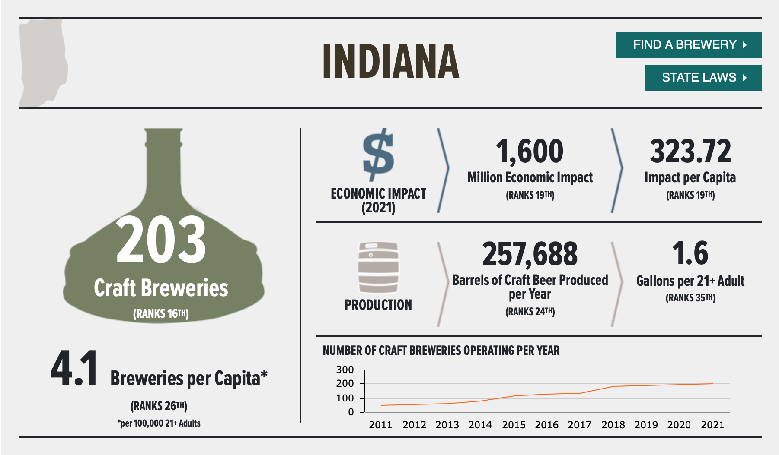
2011 to Present- As of July 31, there were 217 active permits breweries in the state of Indiana with another 9 permit applications pending. Indiana currently ranks 16th in the number of breweries, 26th in breweries per capita, and 19th in economic impact, coming in at a bit over $1.6 billion dollars annually. Not too bad for an industry that didn’t exist until 30 years ago!

Slide 17



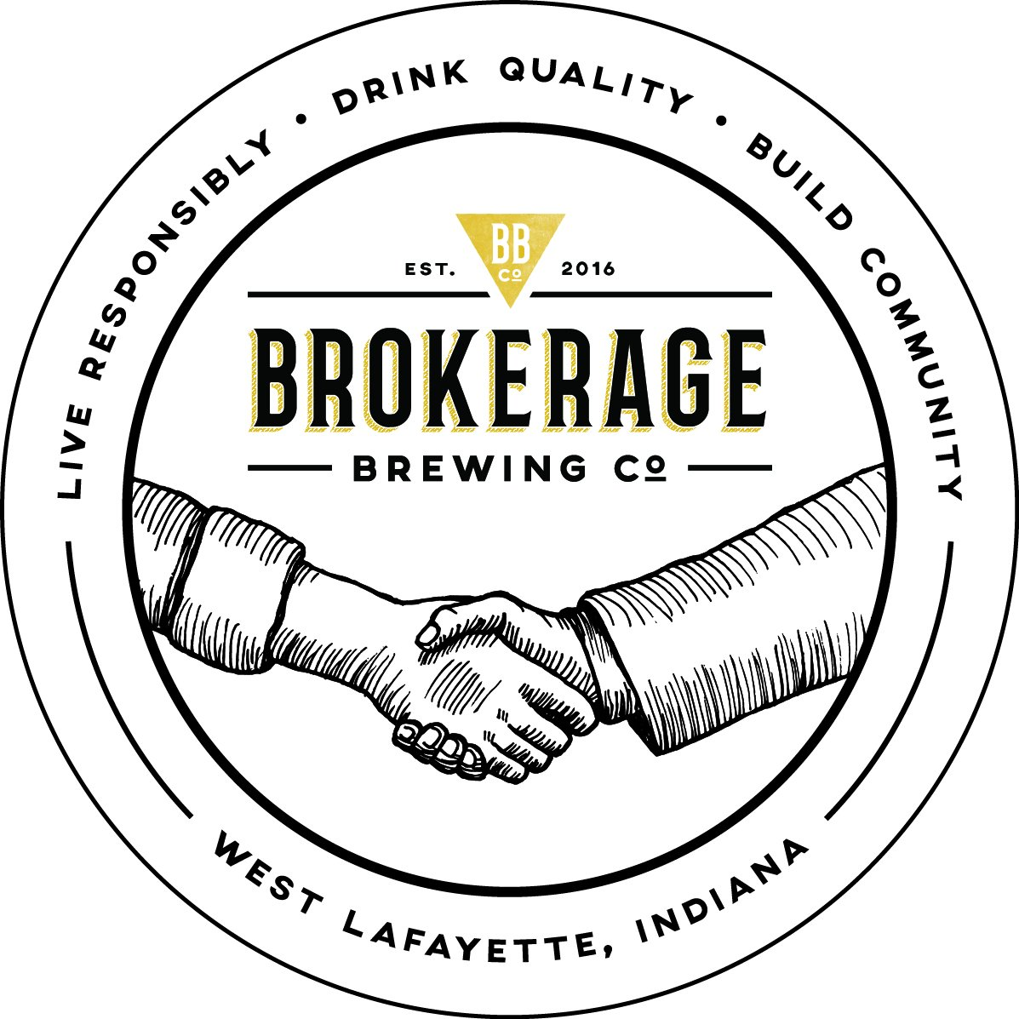
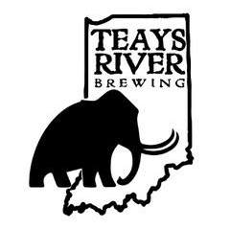

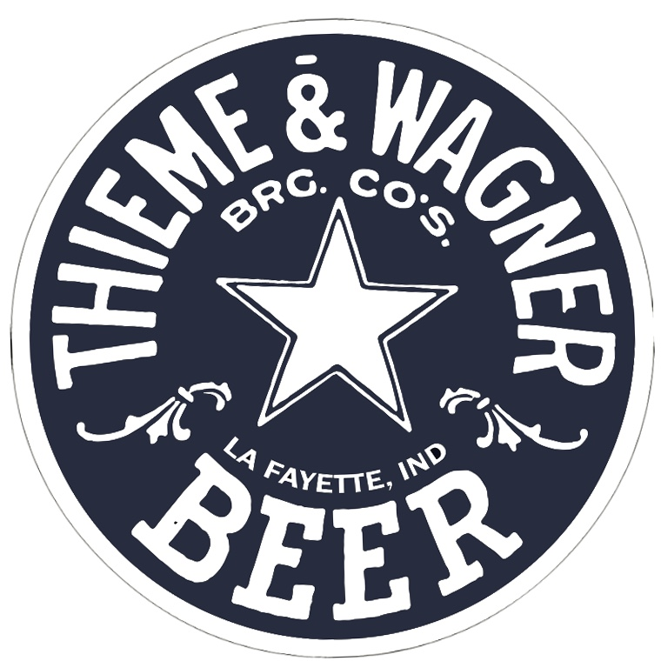
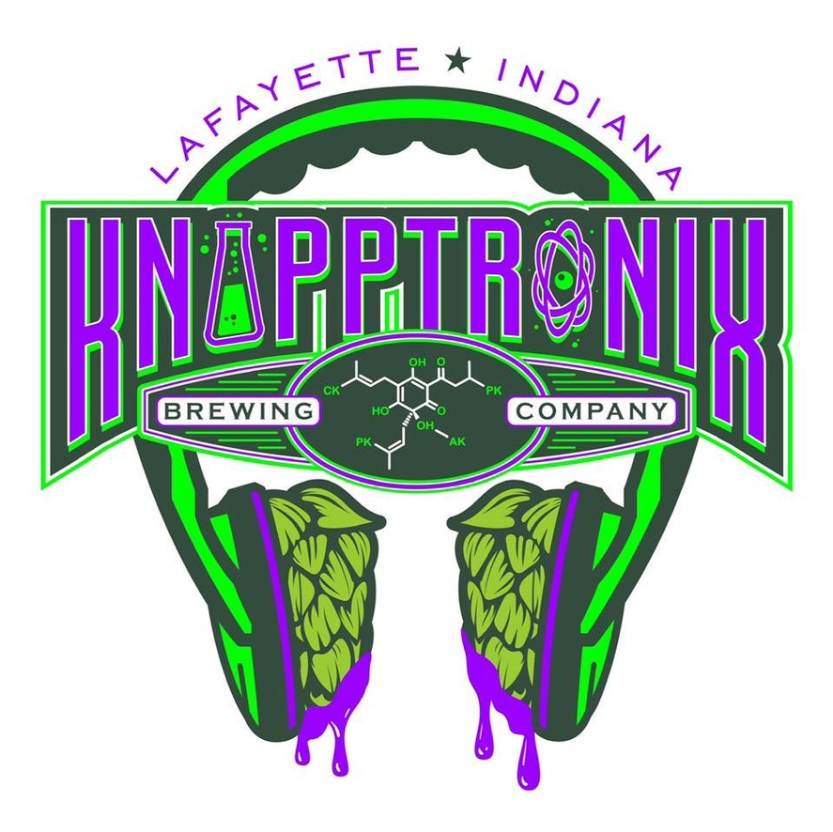
2011 to Present- The Greater Lafayette area currently has 7 operating craft breweries, and several more within a short drive.
Thanks for supporting your local, independent craft breweries!
RESPECT BEER- PLEASE DRINK RESPONSIBLY!

